Slide 1

Dark Wolf Hack Our Drone
Ground Control Systems

Slide 2


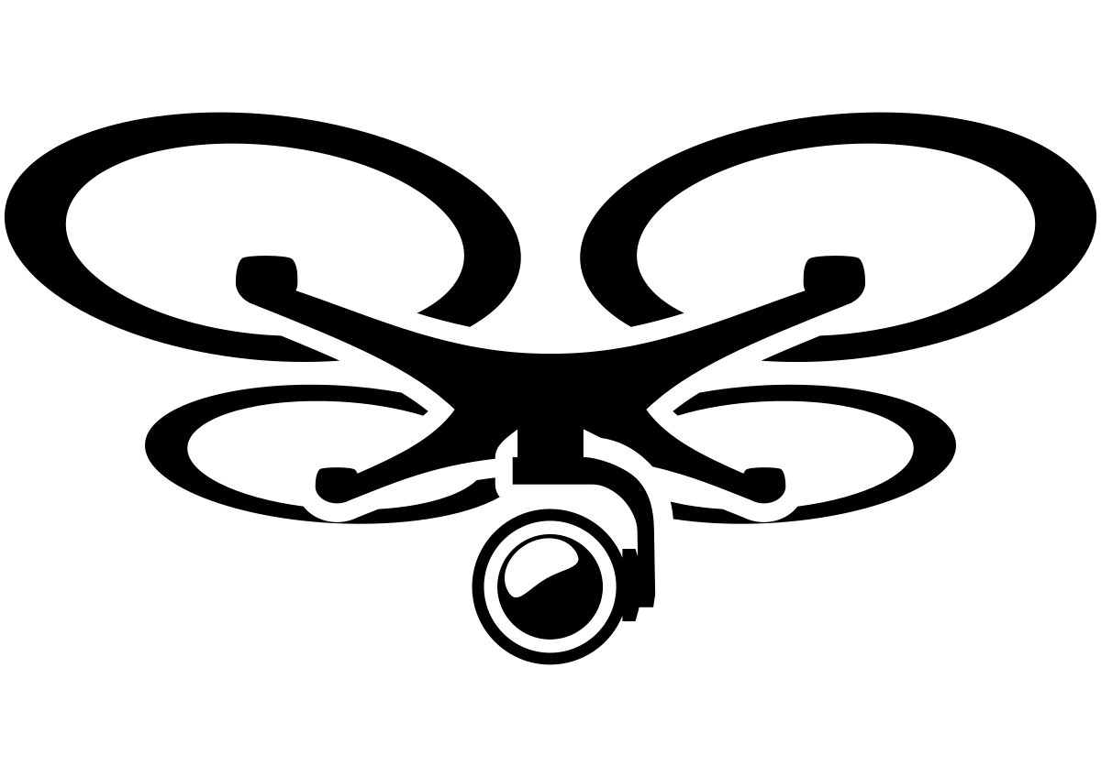


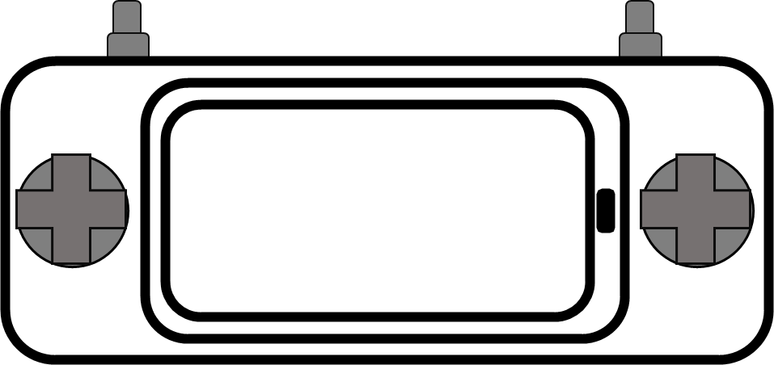
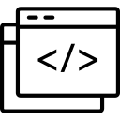
UAS OV1
Ground Control System
Telemetry / C2
MissionPlanner
QGroundControl
RC / Radio Controller
Joystick
GPS
ADS-B
RF
Wifi
Supply Chain
RF
Wifi
Software Libraries

Slide 3
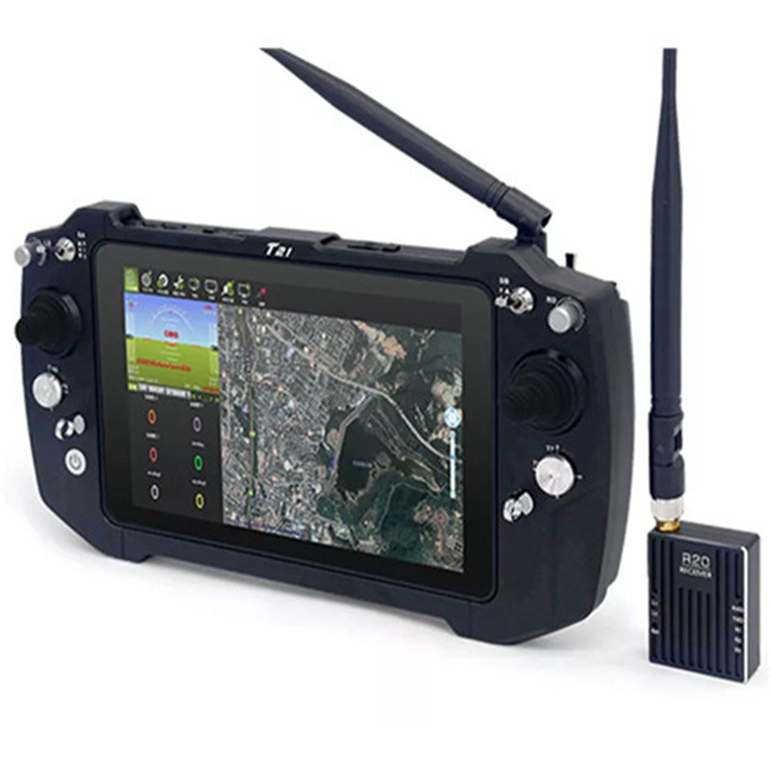
Ground Control System
Handheld or “Desktop”
Can be embedded in packing case
One or more “compute” modules
Authentication
One or more radios
Encryption Keys
Ground Control Software
MissionPlanner
QGroundControl
Payload Data
Imagery
Log Data
Geo-location
Physical Ports (USB, etc)
Network Interfaces

Slide 4
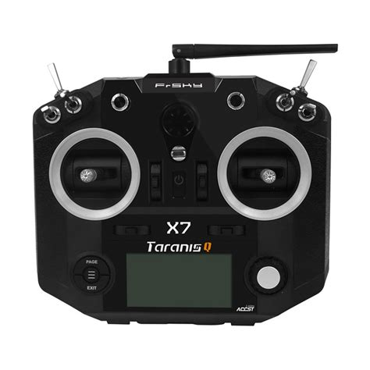
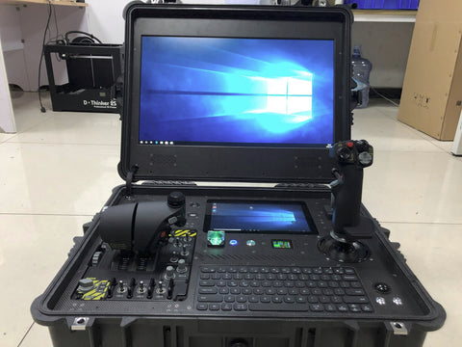
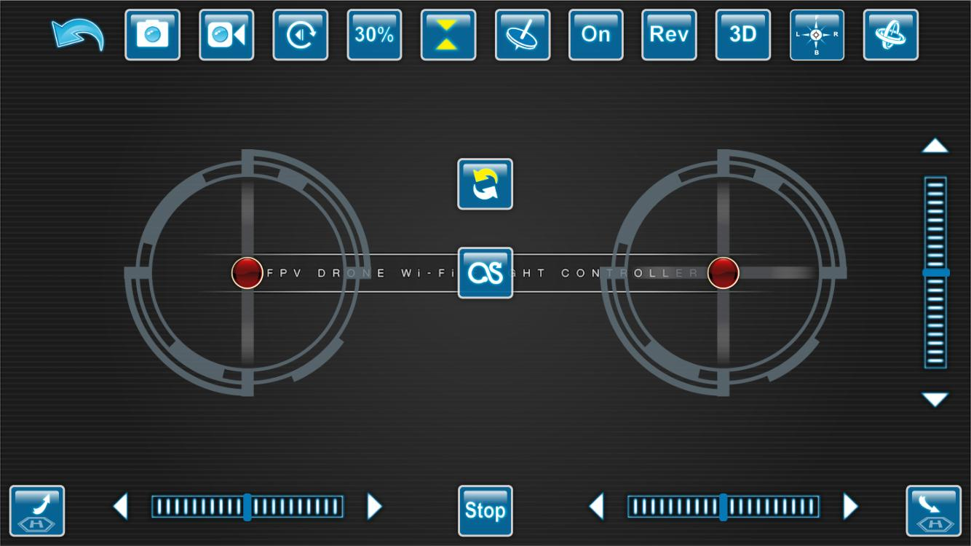
GCS: All things Big and Small
Joystick Controller
Deployable Ground Stations
Android App

Slide 5
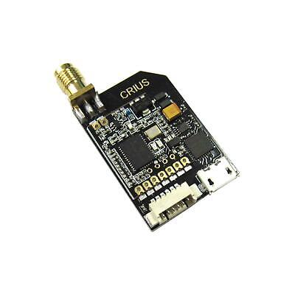
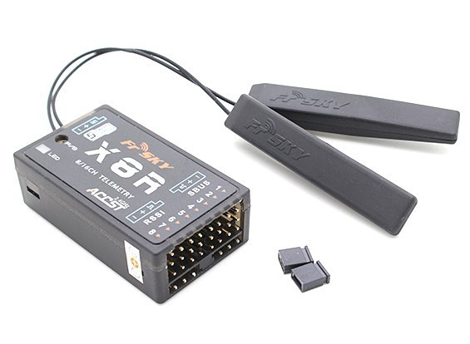
RF Communication: Two Broad Categories
Serial Radio Controller (RC) - Joystick
Protocols:
PPM - Pulse Position Modulation
PCM - Pulse Code Modulation
SBUS - Serial Bus (S.BUS)
etc
Telemetry Radio
Protocols:
Mavlink
https://www.dronetrest.com/t/rc-radio-control-protocols-explained-pwm-ppm-pcm-sbus-ibus-dsmx-dsm2/1357

Slide 6
Ground Control System: Attack Surface
Radio Links
USB Ports
Joystick / Computer Interface
Authentication / Authorization
Ethernet Network Interfaces

Slide 7
GCS: Compute
Hardware Form Factor
Phone
Tablets
Laptops
Operating Systems
Android
Linux
Windows

Slide 8
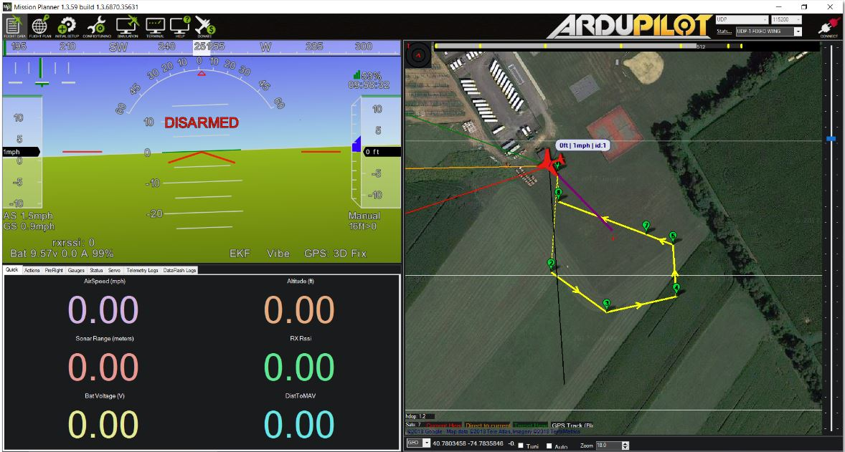
GCS Software: MissionPlanner
Point-and-click waypoint/fence/rally point entry, using Google Maps/Bing/Open street maps/Custom WMS.
Select mission commands from drop-down menus
Download mission log files and analyze them
Configure autopilot settings for your vehicle
Interface with a PC flight simulator to create a full software-in-the-loop (SITL) UAV simulator.
Run its own SITL simulation of many frames types for all the ArduPilot vehicles.

Slide 9
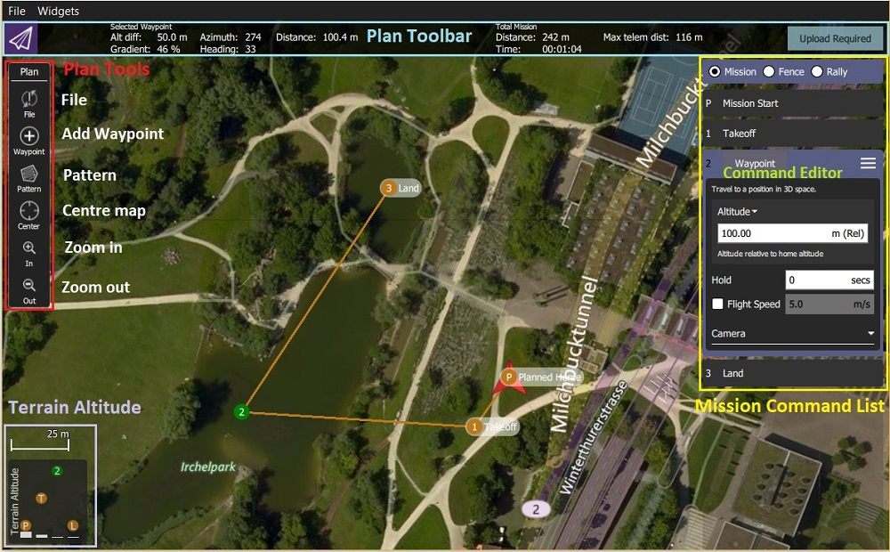
GCS Software: QGroundControl
Full setup/configuration of ArduPilot and PX4 Pro powered vehicles.
Flight support for vehicles running PX4 and ArduPilot (or any other autopilot that communicates using the MAVLink protocol).
Mission planning for autonomous flight.
Flight map display showing vehicle position, flight track, waypoints and vehicle instruments.
Video streaming with instrument display overlays.
Support for managing multiple vehicles.
QGC runs on Windows, OS X, Linux platforms, iOS and Android devices.

Slide 10
UAS Ground Control System
Lab Overview

Slide 11
Hack Our Drone: Comms Lab Task List
Introduction
Login
View Files
Run QGroundControl
Analyze Files
Log Data
Firmware Updates
Unauthenticated File System Access
Capture Credentials
RE WiFi Passphrase
Crack Login Password

